Slide 1
Automatic Forecasting with R
Andy Fisher
andy@dfanalytics.com

Slide 2
Agenda
Forecasting in Supply Chain Management
The R forecast package
Additional considerations

Slide 3
My Relevant Background
Role in Professional Services at the SAS Institute as an Analytical Consultant focused on the implementation of SAS Forecast Server
Role at Cisco Systems, first managing the application of SAS Forecast Server in supply chain consensus demand planning process, then as S&OP Manager, translating supply chain strategies into financial trade-offs

Slide 4
Automatic Forecasting Explained
Automatic forecasting relies on a computer to fit a proper set of models to every series and the computer picks the best one based on some sort of statistical test.
Proper set of models is important. Proper is dependent on the demand patterns or time series properties
An improper set of models can lead to lower forecast performance
An improper statistic for model selection can lead to lower forecast performance
Automatic forecasting is used in situations with more series than forecast analysts can typically handle
Such as supply chain management

Slide 5
Example: Forecast System in Supply Chain Planning
Demand History
Forecast System
Demand Planning System
Inventory Optimization
Product level demand history provides input to forecasting system
Statistical forecasting system provides baseline expectation of future demand
Demand Planners demand plan with Stat forecast as baseline
Expected sales not included in forecast are added by Demand Planners
Once demand plan is finalized, component orders are determined through inventory optimization system
In Supply Chain Management, a good forecast improves delivery times and reduces inventory holding cost

Slide 6
Time Series Forecasting in R stats
Relevant time series fitting functions in the Stats package
arima: fit an ARIMA model to a univariate time series
HoltWinters: computes Holt-Winters filtering of time series
StructTS: fit a structural model for a time series by maximum likelihood
lm: used to fit linear regression models
Relevant forecasting functions in the Stats package
predict.Arima: forecasts from models fitted by arima
predict.HoltWinters: forecasts from models fitted by HoltWinters
predict.StructTS: forecast from models fitted by StructTS
predict.lm: predicted values based on linear object model

Slide 7
Time Series Forecasting in forecast Package
The R forecast package, authored by Rob Hyndman
http://robjhyndman.com/software/forecast/
http://cran.r-project.org/web/packages/forecast/forecast.pdf
Relevant fitting functions
Arima: Fit ARIMA model to univariate time series (largely wrapper for stats package arima)
auto.arima: Fit best ARIMA model to univariate time series
ets: exponential smoothing state space model
Croston: Forecasts for intermittent demand using Croston’s method
Relevant forecasting functions
forecast.Arima: Returns forecasts and other information for Arima and auto.arima fitted models
forecast.ets: Returns forecasts and other information for univariate ets models
forecast.StructTS: Returns forecasts and other information for univariate structural time series models

Slide 8
auto.arima and ets Approach
auto.arima
Automatically determine differencing needed for stationarity
Then automatically estimate models using different AR and MA terms
Forecast model is selected by AIC
ets
Based on the idea that exponential smoothing methods are optimal forecasts from innovations state space models
The triplet (E,T,S) refers to 3 components: error, trend, seasonality
ETS(M,Md,M) refers to a model with multiplicative errors, damped multiplicative trend, multiplicative seasonality
Forecast model is selected by applying all relevant models, optimizing parameters, and selecting the best model by AIC
auto.arima and ets algorithms explained in detail at:
http://robjhyndman.com/papers/forecastpackage.pdf

Slide 9
forecast Package auto.arima
# load forecast package
library(forecast)
# forecast package ARIMA
Inflationmodauto <- auto.arima(Inflationts)
# view Inflationmodauto
Inflationmodauto
Series: Inflationts
ARIMA(0,1,0)
sigma^2 estimated as 3.188: log likelihood=-61.96
AIC=125.92 AICc=126.05 BIC=127.35
# forecast Inflationmodauto
Inflationfcstauto <- forecast.Arima(Inflationmodauto, h=30)
# view Inflationfcstauto
Inflationfcstauto
Point Forecast Lo 80 Hi 80 Lo 95 Hi 95
2012 2.565 0.2767618 4.853238 -0.9345584 6.064558
2013 2.565 -0.6710575 5.801058 -2.3841229 7.514123
2014 2.565 -1.3983449 6.528345 -3.4964129 8.626413
2015 2.565 -2.0114764 7.141476 -4.4341167 9.564117

Slide 10
forecast Package ets Exponential Smoothing
# load forecast package
library(forecast)
# forecast package ets
Inflationets <- ets(Inflationts)
# view Inflationets
Inflationets
ETS(M,Md,N)
Call:
ets(y = Inflationts)
Smoothing parameters:
alpha = 0.0051
beta = 0.0051
phi = 0.8762
Initial states:
l = 14.2541
b = 0.7511
sigma: 0.4079
AIC AICc BIC
132.0158 134.3235 139.3445
# forecast ets
forecastets <- forecast(Inflationets, h=30)

Slide 11
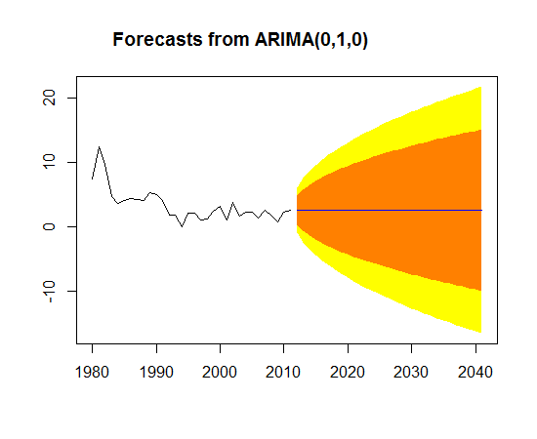
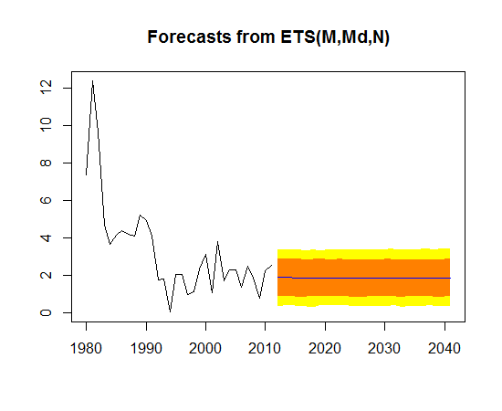
auto.arima and ets Forecasts

Slide 12
Other Relevant Features in forecast Package
forecast package arima and exponential smoothing models can be manually specified, as well as automatically selected
Accuracy: returns a set of accuracy summary measures of forecast accuracy
ACF: auto-correlation function estimation
seasonaldummy: returns matrices of seasonal dummies

Slide 13
Additional Considerations
Forecast package does not do automatic ARIMAX/transfer function specification
This means lags for independent variables will need to be determined by hand
See the ARIMAX model muddle, Rob Hyndman
http://robjhyndman.com/researchtips/arimax/
Database for storage (RODBC, RMySQL, etc.) will be useful
Some series perform better using hierarchical forecasting. Try hts package.
For more flexible management of time series data, try zoo or xts package.

Slide 14
Useful Resources
An R Time Series Tutorial, R.H Shumway and D.S. Stoffer
http://www.stat.pitt.edu/stoffer/tsa2/R_time_series_quick_fix.htm
A Little Book of R for Time Series, Avril Coghlan
http://a-little-book-of-r-for-time-series.readthedocs.org/en/latest/index.html
R Data Import/Export, R Development Core Team
http://cran.r-project.org/doc/manuals/R-data.pdf
CRAN Task View: Time Series Analysis
http://cran.r-project.org/web/views/TimeSeries.html
CRAN Task View: Econometrics
http://cran.r-project.org/web/views/Econometrics.html

